Slide 1


Noida Institute of Engineering and Technology, Greater Noida
JDBC and Servlet
Unit: 1
Advanced Java Programming
AMICSE0601/ACSE0601/ACSEHO601
Ibrar Ahmed
Assistant Professor
CSE
6th Semester
(CSE M.Tech Int./B.Tech)
Ibrar Ahmed AMICSE0601/ACSE0601/ACSEHO601 Unit 1

Slide 2

Faculty Profile
Name | Ibrar Ahmed
Qualification | M. Tech. (Computer Engineering)
Designation | Assistant Professor
Department | Computer Science & Engineering
Total Experience | 5 years
NIET Experience | 3 years
Subject Taught | Python with Django, MEAN Stack, MERN Stack, OOTs Using java, Web Technology, Advanced Java.
Ibrar Ahmed AMICSE0601/ACSE0601/ACSEHO601 Unit 1

Slide 3
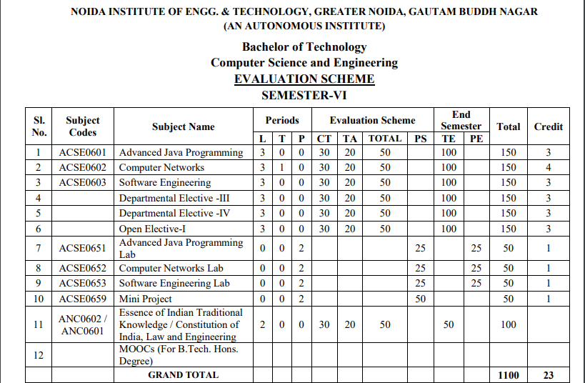
Evaluation Scheme
Ibrar Ahmed AMICSE0601/ACSE0601/ACSEHO601 Unit 1

Slide 4
Syllabus
B. TECH. THIRD-YEAR
Course code |  | ACSE0601 | L T P | Credits
Course title |  | ADVANCED JAVA PROGRAMMING | 3 0 0 | 3
Course objective: Objective of this course is to provide the ability to design console based, GUI based, web based applications, integrated development environment to create, debug and run multi-tier and enterprise-level applications.
Pre-requisites: Basics of C, C++, and basic concept of Core JAVA.
Course Contents / Syllabus
UNIT-I | INTRODUCTION |  |  | 8 Hours
JDBC: Introduction, JDBC Driver, DB Connectivity, Driver Manager, Connection, Statement, Result Set, Prepared Statement, Transaction Management, Stored Procedures. Servlet: Servlet Overview, Servlet API, Servlet Interface, Generic Servlet, HTTP Servlet, Servlet Life Cycle, Redirect requests to other resources, Session Tracking, Event and Listener.
UNIT-II | JSP |  |  | 8 Hours
JSP: Introduction, Overview, JSP Scriptlet Tag, JSP expression Tag, JSP declaration Tag, Life Cycle of JSP, JSP API, Implicit Objects: JSP request, JSP response, JSP config, JSP session, JSP Application, JSP Page Context; JSP Page, JSP Exception.
UNIT-III | Spring 5.0 |  |  | 8 Hours
Spring 5.0: Spring Core Introduction and Overview, Managing Beans, The Spring Container, The Factory Pattern, Dependency Injection (DI), Spring Managed Bean Lifecycle, Constructor Injection, Metadata/ Configuration: Life Cycle Annotations, Java Configuration, XML Free configuration.
Ibrar Ahmed AMICSE0601/ACSE0601/ACSEHO601 Unit 1

Slide 5
Syllabus
UNIT-IV |  | Spring MVC & Spring Boot |  | 8 Hours
Spring MVC: Introduction/Developing Web Application with Spring MVC, Advanced Techniques, Spring Controllers Spring Boot: Spring Boot Starters, CLI, Application Class, Logging, Auto Configuration Classes, Spring Boot dependencies, Spring data JPA introduction and Overview.
UNIT-V |  | JPA |  | 8 Hours
JPA: Introduction & overview of data persistence, Overview of ORM tools, Understanding JPA, Entities: Requirement for Entity Class, Persistent Fields and Properties, Primary keys in Entries, Entity Management,Querying Entities, Entities Relationships.
Course outcome: After completion of this course students will be able to
CO 1 | Understand the concept of implementing the connection between Java and Database using JDBC. |  | K2,K4
CO 2 | Understand, Analyse, and Build dynamic web pages for server-side programming |  | K2,K3
CO 3 | Analyze and design the Spring Core Modules and DI to configure and wire beans (application objects) together |  | K4,K5
CO 4 | Design Model View Controller architecture and ready components that can be used to develop flexible and loosely coupled web applications. |  | K2,K3.K6
CO 5 | Deploy JPA to Map, store, retrieve, and update data from java objects to relational databases and vice versa. |  | K5
Ibrar Ahmed AMICSE0601/ACSE0601/ACSEHO601 Unit 1

Slide 6
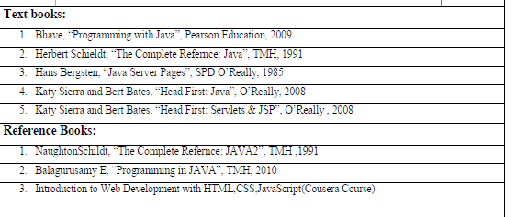
Syllabus
NPTEL/ YouTube/ Faculty Video Link:
Unit1
https://youtu.be/96xF9phMsWA
https://youtu.be/Zopo5C79m2k
Unit 2 https://youtu.be/vHmUVQKXlVo
https://youtu.be/qz0aGYrrlhU
Unit 3 https://youtu.be/GBOK1-nvdU4
https://youtu.be/YpsFT50mths?list=PLd3UqWTnYXOlc93disyBjyFv-r1Vq-5zh
Unit 4 https://youtu.be/-qfEOE4vtxE
https://youtu.be/PkZNo7MFNFg
Unit 5 https://youtu.be/_GMEqhUyyFM
https://youtu.be/ImtZ5yENzgE
Ibrar Ahmed AMICSE0601/ACSE0601/ACSEHO601 Unit 1

Slide 7
Branch Wise Applications
Desktop GUI Applications
Mobile Applications
Enterprise Applications
Scientific Applications
Web-based Applications
Distributed Applications
Cloud-based Applications
Web servers and Application servers
Software Tools
Gaming Applications
Ibrar Ahmed AMICSE0601/ACSE0601/ACSEHO601 Unit 1

Slide 8
Course Objective
To provide the ability to design console based, GUI based ,web based applications.
To design and develop the dynamic web sites using, Servlet and jsp.
To understand the concept of business logic to develop the enterprises application by Spring framework.
To apply the MVC design pattern in developing a live project.
To learn the concept of database handling in java and apply this concept in transactional processing based project.
Ibrar Ahmed AMICSE0601/ACSE0601/ACSEHO601 Unit 1

Slide 9
Course Outcome
At the end of the semester, student will be able to:
Course Outcomes (CO) | CO Description | Blooms’ Taxonomy
CO1 | Understand the concept of implementing the connection between Java and Database using JDBC. | K2, K4
CO2 | Understand, analyze and apply the role of mark up languages like HTML, DHTML, and XML in the workings of the web and web applications. | K2, K3
CO3 | Analyze and design the Spring Core Modules and DI to configure and wire beans (application objects) together | K4,K5
CO4 | Design Model View Controller architecture and ready components that can be used to develop flexible and loosely coupled web applications. | K2, K3, K6
CO5 | Deploy JPA to Map, store, retrieve, and update data from java objects to relational databases and vice versa. | K5
Ibrar Ahmed AMICSE0601/ACSE0601/ACSEHO601 Unit 1

Slide 10
Program Outcome
1. Engineering knowledge:
2. Problem analysis:
3. Design/development of solutions:
4. Conduct investigations of complex problems:
5. Modern tool usage:
6. The engineer and society:
7. Environment and sustainability:
8. Ethics:
9. Individual and team work:
10. Communication:
11. Project management and finance:
12. Life-long learning
Ibrar Ahmed AMICSE0601/ACSE0601/ACSEHO601 Unit 1

Slide 11
CO-PO Mapping
Mapping of Course Outcomes and Program Outcomes:
 | PO1 | PO2 | PO3 | PO4 | PO5 | PO6 | PO7 | PO8 | PO9 | PO10 | PO11 | PO12
ACSE0601.1 | 3 | 3 | 2 | 3 | 3 | 3 | 2 | 3 | 3 | 3 | 2 | 3
ACSE0601.2 | 3 | 2 | 3 | 2 | 3 | 2 | 2 | 2 | 3 | 3 | 3 | 3
ACSE0601.3 | 3 | 3 | 3 | 2 | 3 | 3 | 2 | 3 | 3 | 3 | 2 | 3
ACSE0601.4 | 3 | 3 | 3 | 2 | 3 | 3 | 2 | 3 | 3 | 3 | 3 | 3
ACSE0601.5 | 3 | 3 | 3 | 2 | 3 | 2 | 2 | 3 | 3 | 3 | 3 | 3
Average | 3 | 2.8 | 2.8 | 2.2 | 3 | 2.6 | 2 | 2.8 | 3 | 3 | 2.6 | 3
Ibrar Ahmed AMICSE0601/ACSE0601/ACSEHO601 Unit 1

Slide 12
Program Specific Outcomes
PSO1: Identify, analyze real world problems and design their ethical solutions using artificial intelligence, robotics, virtual/augmented reality, data analytics, block chain technology, and cloud computing..
PSO2: Design and develop the hardware sensor devices and related interfacing software systems for solving complex engineering problems.
PSO3: Understand inter-disciplinary computing techniques and to apply them in the design of advanced computing.
PSO4: Conduct investigation of complex problems with the help of technical, managerial, leadership qualities, and modern engineering tools provided by industry-sponsored laboratories.
Ibrar Ahmed AMICSE0601/ACSE0601/ACSEHO601 Unit 1

Slide 13
COs and PSOs Mapping
*3= High *2= Medium *1 = Low
Mapping of Program Specific Outcomes and Course Outcomes:
Course Outcomes | Program Specific Outcomes
 | PSO1 | PSO2 | PSO3 | PSO4
ACSE0601.1 | 3 | 3 | 2 | 3
ACSE0601.2 | 3 | 3 | 3 | 2
ACSE0601.3 | 3 | 3 | 2 | 2
ACSE0601.4 | 3 | 2 | 3 | 2
ACSE0601.5 | 3 | 2 | 2 | 2
AVG | 3 | 2.6 | 2.4 | 2.2
Ibrar Ahmed AMICSE0601/ACSE0601/ACSEHO601 Unit 1

Slide 14
Program Educational Objectives
PEO1: To have an excellent scientific and engineering breadth so as to comprehend, analyze, design and provide sustainable solutions for real-life problems using state-of-the-art technologies.
PEO2: To have a successful career in industries, to pursue higher studies or to support entrepreneurial endeavors and to face the global challenges.
PEO3: To have an effective communication skills, professional attitude, ethical values and a desire to learn specific knowledge in emerging trends, technologies for research, innovation and product development and contribution to society.
PEO4: To have life-long learning for up-skilling and re-skilling for a successful professional career as an engineer, scientist, entrepreneur or bureaucrat for the betterment of the society.
Ibrar Ahmed AMICSE0601/ACSE0601/ACSEHO601 Unit 1

Slide 15
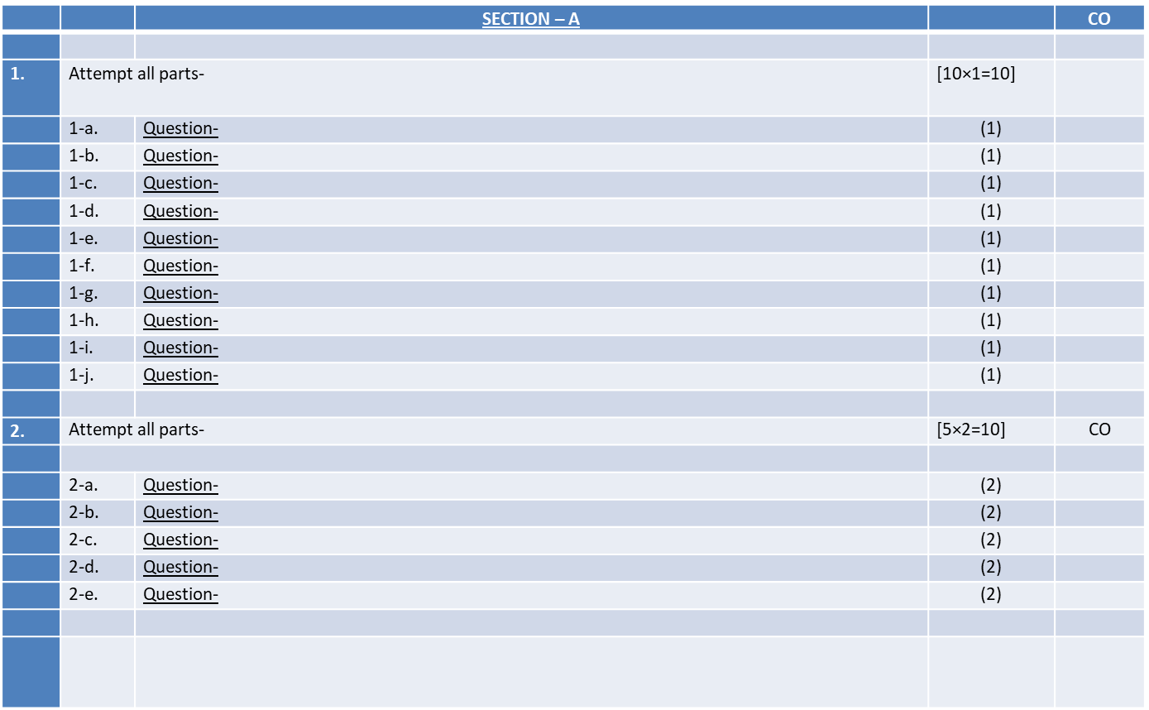
End Semester Question paper Templates
Ibrar Ahmed AMICSE0601/ACSE0601/ACSEHO601 Unit 1

Slide 16
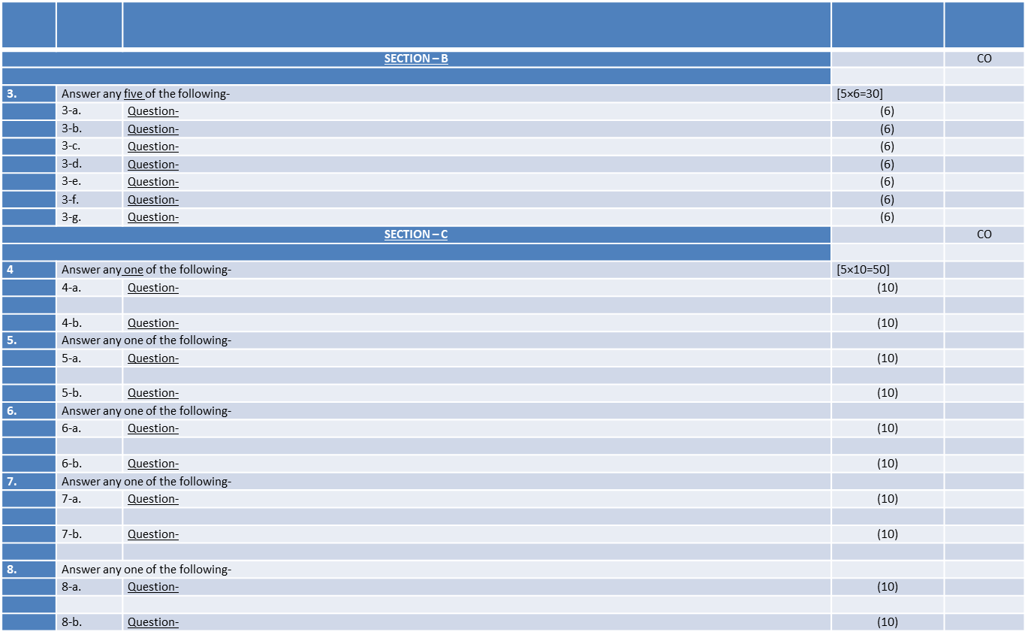
End Semester Question paper Templates
Ibrar Ahmed AMICSE0601/ACSE0601/ACSEHO601 Unit 1

Slide 17
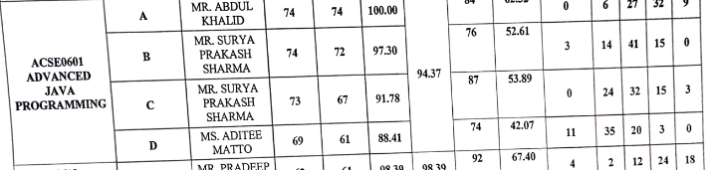
Result Analysis
Ibrar Ahmed AMICSE0601/ACSE0601/ACSEHO601 Unit 1

Slide 18
Prerequisites
Prerequisites:
Having knowledge about core java concepts.
Basic knowledge abut the JDBC concepts.
Basic knowledge about the business logic.
Basic knowledge about MVC design pattern
Basic knowledge about RDBMS query.
Ibrar Ahmed AMICSE0601/ACSE0601/ACSEHO601 Unit 1

Slide 19
Recap
Recap:
Previous concept was focused on object oriented programming.
The main concepts has been discussed about core java functionalities
In core java we have discussed about class,interface,exception handling, multi-threading etc.
Ibrar Ahmed AMICSE0601/ACSE0601/ACSEHO601 Unit 1

Slide 20
Brief Introduction to Subject
Advance Java Programming provides libraries to understand the concept of Client-Server architecture for web- based applications.
We can also work with web and application servers such as Apache Tomcat and Glassfish Using these servers, we can understand the working of HTTP protocol.
It provides a set of services, API and protocols, that provides the functionality which is necessary for developing multi-tiered application, web-based application.
There is a number of advance Java frameworks like, Spring, Hibernate, Struts, that enables us to develop secure transaction-based web applications such as banking application, inventory management application.
https://youtu.be/AGGePFPiNfU?list=PLlhM4lkb2sEjVsbbZ_kiixY5CcR84IQUg
https://youtu.be/96xF9phMsWA
https://youtu.be/Zopo5C79m2k
Ibrar Ahmed AMICSE0601/ACSE0601/ACSEHO601 Unit 1

Slide 21
Topic Mapping with Course Outcome
Topics | Course outcome
JDBC: Introduction, JDBC Driver, DB Connectivity, Driver Manager, Connection, Statement, Result Set, Prepared Statement Transaction Management, Stored Procedures. Servlet: Servlet Overview, Servlet API, Servlet Interface, Generic Servlet, HTTP Servlet, Servlet Life Cycle. Redirect requests to other resources, Session Tracking, Event and Listener | CO1 CO1 CO1 CO1
Ibrar Ahmed AMICSE0601/ACSE0601/ACSEHO601 Unit 1

Slide 22
Unit 1 Content
JDBC: Introduction
JDBC Driver
DB Connectivity
Driver Manager and Connection classes
Statement, Result Set, Prepared Statement, and interface
Transaction Management and Stored Procedures.
Servlet Overview and Servlet API
Servlet Interface, Generic Servlet and HTTP Servlet with Servlet Life Cycle
Redirect requests to other resources, Session Tracking, Event and Listener
Ibrar Ahmed AMICSE0601/ACSE0601/ACSEHO601 Unit 1

Slide 23
Unit Objective
Objective of Unit 1:
To understand the concepts of JDBC(Java Database Connectivity) driver
To understand the use of various types of SQL command in JDBC connectivity.
To understand the concepts of Statement and Prepared Statement interface
To learn the concepts of stored procedure creation in JDBC.
To understand the concepts of Generic Servlet and HTTP Servlet
To understand the concepts of Redirecting the HTTP request
To understand the concepts of session and event handling.
Ibrar Ahmed AMICSE0601/ACSE0601/ACSEHO601 Unit 1

Slide 24
UNIT 1
Topics: JDBC: Introduction, JDBC Driver, DB Connectivity, Driver Manager, Connection, Statement, Result Set, Prepared Statement, Transaction Management, Stored Procedures (CO1)
Objective of the above topics:
  To understand the concepts JDBC
  To understand the concepts of preparing class of JDBC
  To understand the concepts of various types of driver in JDBC
  To understand the concepts of Statement and PreparedStatement.
  To understand the concepts of transaction management
Ibrar Ahmed AMICSE0601/ACSE0601/ACSEHO601 Unit 1

Slide 25
Introduction to JDBC
JDBC
  JDBC stands for Java Database Connectivity.
  JDBC is a Java API to connect and execute the query with the database.
  JDBC API uses JDBC drivers to connect with the database.
Ibrar Ahmed AMICSE0601/ACSE0601/ACSEHO601 Unit 1

Slide 26
Introduction to JDBC(cont..)
JDBC Drivers
JDBC-ODBC Bridge Driver
Native Driver
Network Protocol Driver
Thin Driver or Oracle Driver
Ibrar Ahmed AMICSE0601/ACSE0601/ACSEHO601 Unit 1

Slide 27
Introduction to JDBC(cont..)
Steps for Java Database Connectivity
Import JDBC packages.
Load and register the JDBC driver.
Open a connection to the database.
Create a statement object to perform a query.
Execute the statement object and return a query resultset.
Process the resultset.
Ibrar Ahmed AMICSE0601/ACSE0601/ACSEHO601 Unit 1

Slide 28
Daily Quiz(cont..)
Which middleware services are provided by EJB?
A. Security
B. Transaction Management
C. Both A & B
D. None of the above
What represents a persistent global data from the database?
A. Entity Bean
B. Session Bean
C. Both A & B
D. None of the above
Ibrar Ahmed AMICSE0601/ACSE0601/ACSEHO601 Unit 1

Slide 29
Daily Quiz(cont..)
Which of the following manages a list of database drivers in JDBC?
A - DriverManager
B - JDBC driver
C - Connection
D - Statement
Which of the following is true about JDBC architecture?
A - JDBC API layer provides the application-to- JDBC Manager connection.
B - JDBC Driver API layer supports the JDBC Manager-to-Driver Connection.
C - Both of the above.
D - None of the above.
Ibrar Ahmed AMICSE0601/ACSE0601/ACSEHO601 Unit 1

Slide 30
Previous Topics: Recap
  The previous topic was mainly focused on using java bean classes as a reusable software components
  It was discussed about creating a java bean class and setter and getter properties.
  It was focused on various types beans such as: session and entity bean.
  It was also focused stateless and state ful session bean with example
Ibrar Ahmed AMICSE0601/ACSE0601/ACSEHO601 Unit 1

Slide 31
Topics: Database Connectivity (JDBC): Merging Data from Multiple Tables: Joining, Manipulating ,Databases with JDBC, Prepared Statements, Transaction Processing, Stored Procedures (CO4)
Objective of the above topics:
  To understand the concepts of Java Database Connectivity(JDBC)
  To understand the concepts of using various types of SQL query in JDBC
  To understand the concepts of stored Procedure in JDBC.
  To understand the joining multiple table in JDBC.
Ibrar Ahmed AMICSE0601/ACSE0601/ACSEHO601 Unit 1

Slide 32
Introduction to JDBC
JDBC
  JDBC stands for Java Database Connectivity.
  JDBC is a Java API to connect and execute the query with the database.
  JDBC API uses JDBC drivers to connect with the database.
Ibrar Ahmed AMICSE0601/ACSE0601/ACSEHO601 Unit 1

Slide 33

Ibrar Ahmed AMICSE0601/ACSE0601/ACSEHO601 Unit 1

Slide 34
Introduction to JDBC(cont..)
JDBC Drivers
JDBC-ODBC Bridge Driver
Native Driver
Network Protocol Driver
Thin Driver or 100 % pure Oracle Driver
Ibrar Ahmed AMICSE0601/ACSE0601/ACSEHO601 Unit 1

Slide 35
Introduction to JDBC(cont..)
Steps for Java Database Connectivity
Import JDBC packages.
Load and register the JDBC driver.
Open a connection to the database.
Create a statement object to perform a query.
Execute the statement object and return a query resultset.
Process the resultset.
Close the connection
Ibrar Ahmed AMICSE0601/ACSE0601/ACSEHO601 Unit 1

Slide 36
Introduction to JDBC(cont..)
Manipulating Databases with JDBC
    Inserting Records into Database
    Updating Records into Database
    Deleting Records into Database
Ibrar Ahmed AMICSE0601/ACSE0601/ACSEHO601 Unit 1

Slide 37
Introduction to JDBC(cont..)
Inserting Records with JDBC
try
{
Statement stmt = connection.createStatement(); // Prepare a statement to insert a record
String sql = "INSERT INTO my_table (col_string) VALUES('a string')";
// Execute the insert statement
stmt.executeUpdate(sql);
}
catch (SQLException e) { }
Ibrar Ahmed AMICSE0601/ACSE0601/ACSEHO601 Unit 1

Slide 38
Introduction to JDBC(cont..)
Updating Records with JDBC
try
{
Statement stmt = connection.createStatement(); // Prepare a statement to update a record
String sql = "UPDATE my_table SET col_string='a new string' WHERE col_string = 'a string'"; // Execute the insert statement
int updateCount = stmt.executeUpdate(sql); // updateCount contains the number of updated rows
}
catch (SQLException e) { }
Ibrar Ahmed AMICSE0601/ACSE0601/ACSEHO601 Unit 1

Slide 39
Introduction to JDBC(cont..)
Deleting Records with JDBC
try
{
Statement stmt = connection.createStatement(); // Use TRUNCATE
String sql = "TRUNCATE my_table";
// Use DELETE
sql = "DELETE FROM my_table"; // Execute deletion stmt.executeUpdate(sql);
}
catch (SQLException e) { }
Ibrar Ahmed AMICSE0601/ACSE0601/ACSEHO601 Unit 1

Slide 40
Introduction to JDBC(cont..)
PreparedStatement interface
    The PreparedStatement interface is a subinterface of Statement.
    It is used to execute parameterized query.
    The performance of the application will be faster if you use PreparedStatement interface
    Easy to insert parameters into the SQL statement.
    Enables easier batch updates.
Ibrar Ahmed AMICSE0601/ACSE0601/ACSEHO601 Unit 1

Slide 41
Introduction to JDBC(cont..)
PreparedStatement interface Example
import java.sql.*;
class InsertPrepared{
public static void main(String args[]){
try{
Class.forName("oracle.jdbc.driver.OracleDriver");
Connection con=DriverManager.getConnection("jdbc:oracle:thin:@localhost:1521:xe","system","oracle");
PreparedStatement stmt=con.prepareStatement("insert into Emp values(?,?)");
Ibrar Ahmed AMICSE0601/ACSE0601/ACSEHO601 Unit 1

Slide 42
Introduction to JDBC(cont..)
PreparedStatement interface Example(cont..)
stmt.setInt(1,101);//1 specifies the first parameter in the query
stmt.setString(2,"Ratan");
int i=stmt.executeUpdate();
System.out.println(i+" records inserted");
con.close();
}catch(Exception e){ System.out.println(e);}
}
}
Ibrar Ahmed AMICSE0601/ACSE0601/ACSEHO601 Unit 1

Slide 43
Daily Quiz(cont..)
How many transaction isolation levels provide the JDBC through the Connection interface?
3, 4, 7, 2
Which of the following method is static and synchronized in JDBC API?
getConnection()
prepareCall()
executeUpdate()
executeQuery()
Ibrar Ahmed AMICSE0601/ACSE0601/ACSEHO601 Unit 1

Slide 44
Daily Quiz(cont..)
Which of the following is not a valid statement in JDBC?
Statement
PreparedStatement
QueryStatement
CallableStatement
What does setAutoCommit(false) do?
It will not commit transactions automatically after each query.
It explicitly commits the transaction.
It never commits the transactions.
It does not commit transaction automatically after each query.
Ibrar Ahmed AMICSE0601/ACSE0601/ACSEHO601 Unit 1

Slide 45
Introduction to JDBC(cont..)
Transaction Processing Concepts
Transaction
  The transaction is a set of logically related operation.
  It contains a group of tasks.
  A transaction is an action or series of actions.
  It is performed by a single user to perform operations for accessing the contents of the database.
Ibrar Ahmed AMICSE0601/ACSE0601/ACSEHO601 Unit 1

Slide 46
Introduction to JDBC(cont..)
  Suppose an employee of bank transfers Rs 800 from X's account to Y's account.
  This small transaction contains several low-level tasks:
Transaction Processing Example
X's Account
Open_Account(X)
Old_Balance = X.balance
New_Balance = Old_Balance - 800
X.balance = New_Balance
Close_Account(X)
Ibrar Ahmed AMICSE0601/ACSE0601/ACSEHO601 Unit 1

Slide 47
Introduction to JDBC(cont..)
Transaction Processing Example(cont..)
Y’s Account
Open_Account(Y)
Old_Balance = Y.balance
New_Balance = Old_Balance + 800
Y.balance = New_Balance
Close_Account(Y)
Operation of Transaction
  Read(x)
  Write(x)
Ibrar Ahmed AMICSE0601/ACSE0601/ACSEHO601 Unit 1

Slide 48
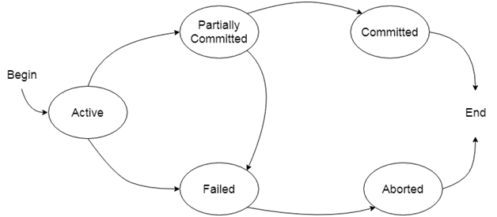
Introduction to JDBC(cont..)
States of Transaction
Ibrar Ahmed AMICSE0601/ACSE0601/ACSEHO601 Unit 1

Slide 49
Introduction to JDBC(cont..)
Transaction Management in JDBC
Atomicity means either all successful or none.
Consistency ensures bringing the database from one consistent state to another consistent state.
Isolation ensures that transaction is isolated from other transaction.
Durability means once a transaction has been committed, it will remain so, even in the event of errors, power loss etc.
Ibrar Ahmed AMICSE0601/ACSE0601/ACSEHO601 Unit 1

Slide 50
Introduction to JDBC(cont..)
Stored Procedure in JDBC
CallableStatement interface is used to call the stored procedures and functions.
We can have business logic on the database by the use of stored procedures and functions that will make the performance better because these are precompiled.
Ibrar Ahmed AMICSE0601/ACSE0601/ACSEHO601 Unit 1

Slide 51
Introduction to JDBC(cont..)
Stored Procedure and Function
Stored Procedure | Function
is used to perform business logic. | is used to perform calculation.
must not have the return type. | must have the return type.
may return 0 or more values. | may return only one values.
We can call functions from the procedure. | Procedure cannot be called from function.
Procedure supports input and output parameters. | Function supports only input parameter.
Exception handling using try/catch block can be used in stored procedures. | Exception handling using try/catch can't be used in user defined functions.
Ibrar Ahmed AMICSE0601/ACSE0601/ACSEHO601 Unit 1

Slide 52
Introduction to JDBC(cont..)
Example to call stored Procedure using JDBC
create or replace procedure "INSERTR"
(id IN NUMBER,
name IN VARCHAR2)
is
begin
insert into user420 values(id,name);
end;
/
Ibrar Ahmed AMICSE0601/ACSE0601/ACSEHO601 Unit 1

Slide 53
Introduction to JDBC(cont..)
Complete Example of Stored Procedure using JDBC
import java.sql.*;
public class Proc {
public static void main(String[] args) throws Exception{
Class.forName("oracle.jdbc.driver.OracleDriver");
Connection con=DriverManager.getConnection(
"jdbc:oracle:thin:@localhost:1521:xe","system","oracle");
CallableStatement stmt=con.prepareCall("{call insertR(?,?)}");
stmt.setInt(1,1011);
stmt.setString(2,"Amit");
stmt.execute();
System.out.println("success");
}
}
Ibrar Ahmed AMICSE0601/ACSE0601/ACSEHO601 Unit 1

Slide 54
Daily Quiz(cont..)
How many transaction isolation levels provide the JDBC through the Connection interface?
3, 4, 7, 2
Which of the following method is static and synchronized in JDBC API?
getConnection()
prepareCall()
executeUpdate()
executeQuery()
Ibrar Ahmed AMICSE0601/ACSE0601/ACSEHO601 Unit 1

Slide 55
Daily Quiz(cont..)
Which of the following is advantage of using JDBC connection pool?
Slow performance
Using more memory
Using less memory
Better performance
Which of the following is advantage of using PreparedStatement in Java?
Slow performance
Encourages SQL injection
Prevents SQL injection
More memory usage
Ibrar Ahmed AMICSE0601/ACSE0601/ACSEHO601 Unit 1

Slide 56
Daily Quiz(cont..)
Which of the following is not a JDBC connection isolation levels?
TRANSACTION_NONE
TRANSACTION_READ_COMMITTED TRANSACTION_REPEATABLE_READ TRANSACTION_NONREPEATABLE_READ
Thin driver is also known as?
Type 3 Driver
Type 2 Driver
Type 4 Driver
Type 1Driver
Ibrar Ahmed AMICSE0601/ACSE0601/ACSEHO601 Unit 1

Slide 57
Daily Quiz(cont..)
Which of the following is not a valid statement in JDBC?
Statement
PreparedStatement
QueryStatement
CallableStatement
What does setAutoCommit(false) do?
It will not commit transactions automatically after each query.
It explicitly commits the transaction.
It never commits the transactions.
It does not commit transaction automatically after each query.
Ibrar Ahmed AMICSE0601/ACSE0601/ACSEHO601 Unit 1

Slide 58
Previous Topics: Recap
  The previous topic was focused on the concepts of Java Database Connectivity(JDBC) with its four types of driver in details.
  It was basically focused on using various types of SQL query in JDBC
  It was focused on various types of statement in JDBC.
  It was discussed about the concepts of stored Procedure in JDBC.
Ibrar Ahmed AMICSE0601/ACSE0601/ACSEHO601 Unit 1

Slide 59
Topics: Servlet: Servlet Overview, Servlet API, Servlet Interface, Generic Servlet, HTTP Servlet, Servlet Life Cycle, Redirect requests to other resources, Session Tracking, Event and Listener.
Objective of the above topics:
  To understand the concepts of servlet API and its developement
  To understand the concepts of developing a servlet class and deploying it
  To understand the concepts of handling HTTP get and post request
  To understand the various types of session tracking,Even and Listener concepts .
Ibrar Ahmed AMICSE0601/ACSE0601/ACSEHO601 Unit 1

Slide 60
Introduction to Servlet
Servlet Overview and Architecture
Servlet is a technology i.e. used to create web application.
Servlet is an API that provides many interfaces and classes including documentations.
Servlet is an interface that must be implemented for creating any servlet.
Servlet is a class that extend the capabilities of the servers and respond to the incoming request. It can respond to any type of requests.
Servlet is a web component that is deployed on the server to create dynamic web page.
Ibrar Ahmed AMICSE0601/ACSE0601/ACSEHO601 Unit 1

Slide 61
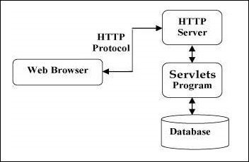
Introduction to Servlet(cont..)
Servlet Architecture
Ibrar Ahmed AMICSE0601/ACSE0601/ACSEHO601 Unit 1

Slide 62
Introduction to Servlet(cont..)
Servlet API Basics
  The javax.servlet and javax.servlet.http packages represent interfaces and classes for servlet API.
  The javax.servlet package contains many interfaces and classes that are used by the servlet or web container.
  The javax.servlet.http package contains interfaces and classes that are responsible for http requests only.
Ibrar Ahmed AMICSE0601/ACSE0601/ACSEHO601 Unit 1

Slide 63
Introduction to Servlet(cont..)
Interfaces in javax.servlet package
  Servlet
  ServletRequest
  ServletResponse
  RequestDispatcher
  ServletConfig
  ServletContext
  SingleThreadModel
Ibrar Ahmed AMICSE0601/ACSE0601/ACSEHO601 Unit 1

Slide 64
Introduction to Servlet(cont..)
Classes in javax.servlet package
  GenericServlet
  ServletInputStream
  ServletOutputStream
  ServletException
Ibrar Ahmed AMICSE0601/ACSE0601/ACSEHO601 Unit 1

Slide 65
Introduction to Servlet(cont..)
Interfaces in javax.servlet.http package
HttpServletRequest
HttpServletResponse
HttpSession
HttpSessionListener
Ibrar Ahmed AMICSE0601/ACSE0601/ACSEHO601 Unit 1

Slide 66
Introduction to Servlet(cont..)
Life Cycle Of Servlet
  Load the Servlet Class.
  Create the Instance of Servlet.
  Call the servlet’s init() method.
  Call the servlet’s service() method.
  Call the servlet’s destroy() method.
Ibrar Ahmed AMICSE0601/ACSE0601/ACSEHO601 Unit 1

Slide 67
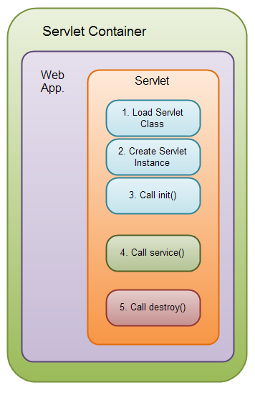
Introduction to Servlet(cont..)
Life Cycle Of Servlet(cont..)
Ibrar Ahmed AMICSE0601/ACSE0601/ACSEHO601 Unit 1

Slide 68
Daily Quiz
How constructor can be used for a servlet?
a) Initialization
b) Constructor function
c) Initialization and Constructor function
d) Setup() method
Can servlet class declare constructor with ServletConfig object as an argument?
a) True
b) False
How is the dynamic interception of requests and responses to transform the information done?
a) servlet container
b) servlet config
c) servlet context
d) servlet filter
Ibrar Ahmed AMICSE0601/ACSE0601/ACSEHO601 Unit 1

Slide 69
Daily Quiz(cont..)
When init() method of servlet gets called?
A - The init() method is called when the servlet is first created.
B - The init() method is called whenever the servlet is invoked.
C - Both of the above.
D - None of the above.
What is javax.servlet.http.HttpServlet?
A - interface
B - abstract class
C - concreate class
D - None of the above.
Ibrar Ahmed AMICSE0601/ACSE0601/ACSEHO601 Unit 1

Slide 70
Introduction to Servlet(cont..)
Running First Servlet Program
import javax.servlet.GenericServlet;
import javax.servlet.ServletException;
import javax.servlet.ServletRequest;
import javax.servlet.ServletResponse;
import java.io.IOException;
public class FirstServlet extends GenericServlet
{
public void service(ServletRequest request, ServletResponse response)
throws ServletException, IOException
{
PrintWriter out=res.getWriter();
out.println(“Hello This is First Servlet”); }
Ibrar Ahmed AMICSE0601/ACSE0601/ACSEHO601 Unit 1

Slide 71
Introduction to Servlet(cont..)
Configuring and Mapping a Servlet
<?xml version="1.0" encoding="ISO-8859-1"?>
<web-app>
<servlet>
<servlet-name>FirstServlet</servlet-name>
<servlet-classFirstServlet </servlet-class>
</servlet>
<servlet-mapping>
<servlet-name> FirstServlet </servlet-name>
<url-pattern >/FirstServlet/* </url-pattern>
</servlet-mapping>
</web-app>
Ibrar Ahmed AMICSE0601/ACSE0601/ACSEHO601 Unit 1

Slide 72
Introduction to Servlet(cont..)
Handling HTTP Request
  The request sent by the computer to a web server, contains all sorts of potentially interesting information; it is known as HTTP requests.
Handling HTTP GET requests
  Handling GET requests involves overriding the doGet method
  By handling HTTP get request, the client URL shows as string and this can be accessed any time.
Ibrar Ahmed AMICSE0601/ACSE0601/ACSEHO601 Unit 1

Slide 73
Introduction to Servlet(cont..)
Example of Handling HTTP get request
public class BookDetailServlet extends HttpServlet
{
public void doGet (HttpServletRequest request, HttpServletResponse response) throws ServletException, IOException
{ ... // set content-type header before accessing the Writer response.setContentType("text/html");
response.setContentType("text/html"); PrintWriter out = response.getWriter();
out.println("<html>" + "<head><title>Book Description</title></head>" + ...);
Ibrar Ahmed AMICSE0601/ACSE0601/ACSEHO601 Unit 1

Slide 74
Introduction to Servlet(cont..)
Example of Handling HTTP get request(cont..)
String bookId = request.getParameter("bookId"); if (bookId != null)
{ // and the information about the book and print it ... } out.println("</body></html>");
out.close();
}
...
}
Ibrar Ahmed AMICSE0601/ACSE0601/ACSEHO601 Unit 1

Slide 75
Introduction to Servlet(cont..)
Handling POST Requests
Handling POST requests involves overriding the doPost method.
Handling HTTP post request URL does not shows as string
and data can not be accessed by another user.
This method is much secure
Ibrar Ahmed AMICSE0601/ACSE0601/ACSEHO601 Unit 1

Slide 76
Introduction to Servlet(cont..)
Example of Handling HTTP get request
public class ReceiptServlet extends HttpServlet
{
public void doPost(HttpServletRequest request, HttpServletResponse response) throws ServletException, IOException
{ ... // set content type header before accessing the Writer response.setContentType("text/html"); PrintWriter out = response.getWriter(); // then write the response out.println("<html>" + "<head><title> Receipt </title>" + ...); out.println("<h3>Thank you for purchasing your books from us " + request.getParameter("cardname") + ...); out.close(); } ... }
Ibrar Ahmed AMICSE0601/ACSE0601/ACSEHO601 Unit 1

Slide 77
Introduction to Servlet(cont..)
HTTP Request | Description
GET | Asks to get the resource at the requested URL.
POST | Asks the server to accept the body info attached. It is like GET request with extra info sent with the request.
HEAD | Asks for only the header part of whatever a GET would return. Just like GET but with no body.
TRACE | Asks for the loopback of the request message, for testing or troubleshooting.
PUT | Says to put the enclosed info (the body) at the requested URL.
DELETE | Says to delete the resource at the requested URL.
OPTIONS | Asks for a list of the HTTP methods to which the thing at the request URL can respond
Ibrar Ahmed AMICSE0601/ACSE0601/ACSEHO601 Unit 1

Slide 78
Introduction to Servlet(cont..)
Redirecting Requests to Other Resources
    The sendRedirect() method of HttpServletResponse
    interface can be used to redirect response to another resource
    This method actually makes the client(browser) to create a new request to get to the resource.
    The client can see the new url in the browser.
    sendRedirect() accepts relative URL, so it can go for resources inside or outside the server.
Ibrar Ahmed AMICSE0601/ACSE0601/ACSEHO601 Unit 1

Slide 79
Introduction to Servlet(cont..)
Example of Redirecting Requests to Other Resources
import java.io.*;
import javax.servlet.*;
import javax.servlet.http.*;
public class RedirectServlet extends HttpServlet{
public void doGet(HttpServletRequest req,HttpServletResponse res)
throws ServletException,IOException
{
res.setContentType("text/html");
PrintWriter out=res.getWriter();
res.sendRedirect("http://www.google.com");
}
}
Ibrar Ahmed AMICSE0601/ACSE0601/ACSEHO601 Unit 1

Slide 80
Introduction to Servlet(cont..)
Session Tracking in Servlet
  Session simply means a particular interval of time.
  Session Tracking is a way to maintain state (data) of an user.
  Http protocol is a stateless so we need to maintain state using session tracking techniques
  Each time user requests to the server, server treats the request as the new request
  So we need to maintain the state of an user to recognize to particular user.
Ibrar Ahmed AMICSE0601/ACSE0601/ACSEHO601 Unit 1

Slide 81
Daily Quiz(cont..)
Which of the following code is used to get session in servlet?
A - request.getSession()
B - response.getSession()
C - new Session()
D - None of the above.
Which of the following code retrieves the request header?
A - Header.getHeaderName(headerName)
B - response.getHeader(headerName)()
C - request.getHeader(headerName)
D - None of the above.
Ibrar Ahmed AMICSE0601/ACSE0601/ACSEHO601 Unit 1

Slide 82
Daily Quiz(cont..)
Which of the following code retrieves the fully qualified name of the client making this request?
A - request.getRemoteHost()
B - response.getRemoteHost()
C - Header.getRemoteHost()
D - None of the above.
Which of the following code can be used to send an error response to the client using the specified status code and clearing the buffer.
A - request.sendError(statusCode)
B - response.sendError(statusCode)
C - header.sendError(statusCode)
D - None of the above.
Ibrar Ahmed AMICSE0601/ACSE0601/ACSEHO601 Unit 1

Slide 83
Introduction to Servlet(cont..)
Cookies In Servlet
  A cookie is a small piece of information that is persisted between the multiple client requests.
  The cookie class provides an easy way for servlet to read, create, and manipulate HTTP-style cookies, which allows servlets to store small amount of data.
  A servlet uses the getCookies() method to retrieve cookies as request.
  The addCookie() method sends a new cookie to the browser
Ibrar Ahmed AMICSE0601/ACSE0601/ACSEHO601 Unit 1

Slide 84
Introduction to Servlet(cont..)
Cookies Example
<cookie.html>
<html>
<body>
<center>
<h1>Cookies Example in Java</h1>
<form action=“"http://localhost:8080/cookies/co” method="Post">
First name: <input type="text" name="fname">
Last name: <input type="text" name="lname">
<input type="submit“ value="SUBMIT">
</form>
</center> </body> </html
Ibrar Ahmed AMICSE0601/ACSE0601/ACSEHO601 Unit 1

Slide 85
Introduction to Servlet(cont..)
Cookies Example(cont..)
<AddCookie.java>
import javax.servlet.*;
import javax.servlet.http.*;
import java.io.*;
public class AddCookie extends HttpServlet
{
public void doPost(HttpServletRequest req,HttpServletResponse res) throws ServletException,IOException
{
Ibrar Ahmed AMICSE0601/ACSE0601/ACSEHO601 Unit 1

Slide 86
Introduction to Servlet(cont..)
Cookies Example(cont..)
<AddCookie.java>(cont..)
String fname=req.getParameter("fname");
String lname=req.getParameter("lname");
Cookie f=new Cookie("first_name",fname);
Cookie l=new Cookie("last_name",lname);
res.addCookie(f);
res.addCookie(l);
res.sendRedirect("http://localhost:8080/cookies/st”);
}
}
Ibrar Ahmed AMICSE0601/ACSE0601/ACSEHO601 Unit 1

Slide 87
Introduction to Servlet(cont..)
Cookies Example(cont..)
out.println("<h1>");
Cookie[] c=req.getCookies();
for(Cookie k:c)
{
out.println(k.getValue());
}
out.println("</h1>");
}
}
<GetCookie.java>
import javax.servlet.*;
import javax.servlet.http.*;
import java.io.*;
public class GetCookie extends HttpServlet
{
public void doGet(HttpServletRequest req,HttpServletResponse res) throws ServletException,IOException
{
PrintWriter out=res.getWriter();
Ibrar Ahmed AMICSE0601/ACSE0601/ACSEHO601 Unit 1

Slide 88
Introduction to Servlet(cont..)
Session Tracking using HTTPSession interface
  The HttpServletRequest interface provides two methods to get the object of HttpSession
        public HttpSession getSession()
        public HttpSession getSession(boolean create)
Ibrar Ahmed AMICSE0601/ACSE0601/ACSEHO601 Unit 1

Slide 89
Introduction to Servlet(cont..)
Example of Session Tracking using HTTPSession interface
<Index.html>
<form action="servlet1">
Name:<input type="text" name="userName"/><br/>
<input type="submit" value="go"/>
</form>
Ibrar Ahmed AMICSE0601/ACSE0601/ACSEHO601 Unit 1

Slide 90
Introduction to Servlet(cont..)
Example of Session Tracking using HTTPSession interface
<FirstServlet.java>
import java.io.*;
import javax.servlet.*;
import javax.servlet.http.*;
public class FirstServlet extends HttpServlet {
public void doGet(HttpServletRequest request, HttpServletResponse response){
try{
response.setContentType("text/html");
PrintWriter out = response.getWriter();
String s1=request.getParameter("userName");
out.print("Welcome "+s1);
Ibrar Ahmed AMICSE0601/ACSE0601/ACSEHO601 Unit 1

Slide 91
Introduction to Servlet(cont..)
Example of Session Tracking using HTTPSession interface(cont..)
<FirstServlet.java>
HttpSession session=request.getSession();
session.setAttribute(“First",s1);
out.print("<a href='servlet2'>visit</a>");
out.close();
}catch(Exception e){System.out.println(e);}
}
}
Ibrar Ahmed AMICSE0601/ACSE0601/ACSEHO601 Unit 1

Slide 92
Introduction to Servlet(cont..)
Example of Session Tracking using HTTPSession interface(cont..)
<SecondServlet.java>
import java.io.*;
import javax.servlet.*;
import javax.servlet.http.*;
public class SecondServlet extends HttpServlet {
public void doGet(HttpServletRequest request, HttpServletResponse response)
try{
PrintWriter out = response.getWriter();
HttpSession session=request.getSession(false);
Ibrar Ahmed AMICSE0601/ACSE0601/ACSEHO601 Unit 1

Slide 93
Introduction to Servlet(cont..)
Example of Session Tracking using HTTPSession interface(cont..)
<SecondServlet.java>
String n=(String)session.getAttribute(“First");
out.print("Hello "+n);
out.close();
}catch(Exception e){System.out.println(e);}
}
}
Ibrar Ahmed AMICSE0601/ACSE0601/ACSEHO601 Unit 1

Slide 94
_x000b_Event and Listener in Servlet
Events are basically occurrence of something. Changing the state of an object
We can perform some important tasks at the occurrence of these exceptions, such as counting total and current logged-in users, creating tables of the database at time of deploying the project, creating database connection object
Ibrar Ahmed AMICSE0601/ACSE0601/ACSEHO601 Unit 1

Slide 95
Event Class in Servlet
ServletRequestEvent
ServletContextEvent
ServletRequestAttributeEvent
ServletContextAttributeEvent
HttpSessionEvent
HttpSessionBindingEvent
Ibrar Ahmed AMICSE0601/ACSE0601/ACSEHO601 Unit 1

Slide 96
Event Interface in Servlet
ServletRequestListener
ServletRequestAttributeListener
ServletContextListener
ServletContextAttributeListener
HttpSessionListener
HttpSessionAttributeListener
HttpSessionBindingListener
HttpSessionActivationListener
Ibrar Ahmed AMICSE0601/ACSE0601/ACSEHO601 Unit 1

Slide 97
ServletContextEvent and ServletContextListener
The ServletContextEvent is notified when web application is deployed on the server
There is only one constructor defined in the ServletContextEvent class.
The web container creates the instance of ServletContextEvent after the ServletContext instance.
Ibrar Ahmed AMICSE0601/ACSE0601/ACSEHO601 Unit 1

Slide 98
Example of ServletContextEvent and ServletContextListener
index.html
<a href="servlet1">fetch records</a>
Ibrar Ahmed AMICSE0601/ACSE0601/ACSEHO601 Unit 1

Slide 99
Example of ServletContextEvent and ServletContextListener(Cont..)
MyListener.java
import javax.servlet.*;
import java.sql.*;
public class MyListener implements ServletContextListener{
public void contextInitialized(ServletContextEvent event) {
try{
Class.forName("oracle.jdbc.driver.OracleDriver");
Connection con=DriverManager.getConnection(
"jdbc:oracle:thin:@localhost:1521:xe","system","oracle");
//storing connection object as an attribute in ServletContext
ServletContext ctx=event.getServletContext();
ctx.setAttribute("mycon", con);
}catch(Exception e){e.printStackTrace();}
}
public void contextDestroyed(ServletContextEvent arg0) {}
}
Ibrar Ahmed AMICSE0601/ACSE0601/ACSEHO601 Unit 1

Slide 100
Example of ServletContextEvent and ServletContextListener(Cont..)
MyListener.java
import java.io.*;
import javax.servlet.*;
import javax.servlet.http.*;
import java.sql.*;
public class FetchData extends HttpServlet {
public void doGet(HttpServletRequest request, HttpServletResponse response)
throws ServletException, IOException {
response.setContentType("text/html");
PrintWriter out = response.getWriter();
try{
//Retrieving connection object from ServletContext object
ServletContext ctx=getServletContext();
Connection con=(Connection)ctx.getAttribute("mycon");
//
Ibrar Ahmed AMICSE0601/ACSE0601/ACSEHO601 Unit 1

Slide 101
Example of ServletContextEvent and ServletContextListener(Cont..)
retieving data from emp32 table
PreparedStatement ps=con.prepareStatement("select * from emp32",
ResultSet.TYPE_SCROLL_SENSITIVE,ResultSet.CONCUR_UPDATABLE);
ResultSet rs=ps.executeQuery();
while(rs.next()){
out.print("<br>"+rs.getString(1)+" "+rs.getString(2));
}
con.close();
}catch(Exception e){e.printStackTrace();}
out.close();
}
}
Ibrar Ahmed AMICSE0601/ACSE0601/ACSEHO601 Unit 1

Slide 102
Previous Topics: Recap
  The previous topic was mainly focused on the concepts of Java Servlet API and its life cycle.
  It was focused on the various types of classes and interfaces
  It was also focused on the concept of redirecting HTTP request
  It was also focused on servlet event and listener classes with its implementation
Ibrar Ahmed AMICSE0601/ACSE0601/ACSEHO601 Unit 1

Slide 103
Daily Quiz(cont..)
Which of the following code is used to get session in servlet?
A - request.getSession()
B - response.getSession()
C - new Session()
D - None of the above.
Which of the following code is used to get session id of a HTTP Session object in servlets?
A - session.getSessionId()
B - session.getId()
C - session.getActiveId()
D - None of the above.
Ibrar Ahmed AMICSE0601/ACSE0601/ACSEHO601 Unit 1

Slide 104
Daily Quiz(cont..)
Three methods of Servlet interface init(), service() and destroy()
i) True
ii) False
Cookie is a piece of information that stored on server ?
i) True
ii) False
Session is series of request for a single user.
i) True
ii) False
init() method in servlet life cycle call again and again
i) True
ii) False
Ibrar Ahmed AMICSE0601/ACSE0601/ACSEHO601 Unit 1

Slide 105
Daily Quiz(cont..)
In CGI based application for every request server create a child process
i) True
ii) False
Servlet Container is also called Servlet Manager .
i) True
ii) False
Ibrar Ahmed AMICSE0601/ACSE0601/ACSEHO601 Unit 1

Slide 106
Weekly Assignment
Discuss the servlet life cycle and its API in details
Write a program to implement handling HTTP post request.
Write a program to implement cookies in servlet
Write a program that implement PreparedStatement in JDBC.
Write a program to implement joining two table in JDBC
Ibrar Ahmed AMICSE0601/ACSE0601/ACSEHO601 Unit 1

Slide 107
YouTube & NPTEL Video Links and Online Courses Details
https://www.youtube.com/watch?v=utANrHfAh28
https://www.digimat.in/nptel/courses/video/106105191/L01.html
https://www.youtube.com/watch?v=y_YxwyYRJek
https://www.youtube.com/watch?v=0SFVFe6a
https://www.youtube.com/watch?v=ajhWv31oN1k KK8
https://www.youtube.com/watch?v=v5vLuCBv8vg
https://www.youtube.com/watch?v=5ammL5KU4mo
Ibrar Ahmed AMICSE0601/ACSE0601/ACSEHO601 Unit 1

Slide 108
Unit 1 MCQ s
1. The JDBC API has always supported persistent storage of objects defined in the Java programming language through the methods getObject and setObject.
a. True
b. False
2. The ACID properties does not describes the transaction management well.
a.True
b. False
3. The ResultSet.next method is used to move to the next row of the ResultSet, making it the current row.
a. True
b. False
Ibrar Ahmed AMICSE0601/ACSE0601/ACSEHO601 Unit 1

Slide 109
Unit 1 MCQ s(cont..)
4. How many steps are used to connect any java application using JDBC?
a. 5
b. 4
c. 3
d. 6
5. In the following JDBC drivers which is known as fully java driver?
a. Native-API driver
b. Network Protocol driver
c. Thin driver
d. Both B & C
Ibrar Ahmed AMICSE0601/ACSE0601/ACSEHO601 Unit 1

Slide 110
Unit 1 MCQ s(cont..)
6. Which models do the JDBC API support for the database access?
a. Two-tier models
b. Three-tier models
c. Both A & B
d. None of the above
7. Which of the following JDBC drivers is known as a partially java driver?
a. JDBC-ODBC bridge driver
b. Native-API driver
c. Network Protocol driver
d. Thin driver
Ibrar Ahmed AMICSE0601/ACSE0601/ACSEHO601 Unit 1

Slide 111
Unit 1 MCQ s(cont..)
8. How many types of JDBC drivers are available?
a. 3
b. 4
c. 2
d. 5
9. How many JDBC product components does the Java software provides?
a. 3
b. 2
c. 4
d. 5
Ibrar Ahmed AMICSE0601/ACSE0601/ACSEHO601 Unit 1

Slide 112
Unit 1 MCQ s(cont..)
10. Which services are provided to EJB components by the EJB container?
a. Transaction support
b. Persistence support
c. Naming support
d. All mentioned above
11. Which session bean maintain their state between client invocations but are not required to maintain their state across server crashes or shutdowns?
a. Stateful Session Bean
b. Stateless Session Bean
c. Singleton Session Bean
d. None of the above
Ibrar Ahmed AMICSE0601/ACSE0601/ACSEHO601 Unit 1

Slide 113
Unit 1 MCQ s(cont..)
18. Which of the following is used to call stored procedure?
a.Statement
b.PreparedStatement
c.CallableStatment
d. CalledStatement
19. Which of the following is method of JDBC batch process?
a. setBatch()
b. deleteBatch()
c. removeBatch()
d. addBatch()
Ibrar Ahmed AMICSE0601/ACSE0601/ACSEHO601 Unit 1

Slide 114
Unit 1 MCQ s(cont..)
8. Which method is used to send the same request and response objects to another servlet in RequestDispacher ?
a. forward()
b. sendRedirect()
c. Both A & B
d. None of the above
9. Which packages represent interfaces and classes for servlet API?
a. javax.servlet
b. javax.servlet.http
c. Both A & B
d. None of the above
Ibrar Ahmed AMICSE0601/ACSE0601/ACSEHO601 Unit 1

Slide 115
Unit 1 MCQ s(cont..)
10. Which HTTP Request method is non-idempotent
a. GET
b. POST
c. BOTH A & B
d. None of the above
11. Which object is created by the web container at time of deploying the project?
a. ServletConfig
b. ServletContext
c. Both A & B
d. None of the above
Ibrar Ahmed AMICSE0601/ACSE0601/ACSEHO601 Unit 1

Slide 116
Unit 1 MCQ s(cont..)
12. In HTTP Request what asks for the loopback of the request message, for testing or for troubleshooting?
a. PUT
b. OPTIONS
c. DELETE
d. TRACE
13. Which one of the following scopes does the attribute in servlet is an object that can be set, get or removed?
a. session scope
b. request scope
c. application scope
d. All mentioned above
Ibrar Ahmed AMICSE0601/ACSE0601/ACSEHO601 Unit 1

Slide 117
Glossary Questions
The------------interface is used to call stored procedure?
a) Statement
b) PreparedStatement
c) CallableStatment
d) CalledStatement
The-----------method is used to rollback a JDBC transaction?
a) rollback()
b) rollforward()
c) deleteTransaction()
d) RemoveTransaction()
Ibrar Ahmed AMICSE0601/ACSE0601/ACSEHO601 Unit 1

Slide 118
Glossary Questions
3. EJB stands for---------------
A - Enterprise J2EE Bean
B - Enterprise Java Bean
C - Enterprise Java oBject
D - Entity Java object
4. --------------interface session bean is used in EJB.
a) EJBRemote
b) EJBHome
c) Remote
Ibrar Ahmed AMICSE0601/ACSE0601/ACSEHO601 Unit 1

Slide 119
Glossary Questions
The Java __________ specification defines an application programming interface for communication between the Web server and the application program.
a) Servlet
b) Server
c) Program
The --------------- application servers do not provide built in support for servlets.
a) Tomcat server
b) Glassfish
c) Jboss
Ibrar Ahmed AMICSE0601/ACSE0601/ACSEHO601 Unit 1

Slide 120
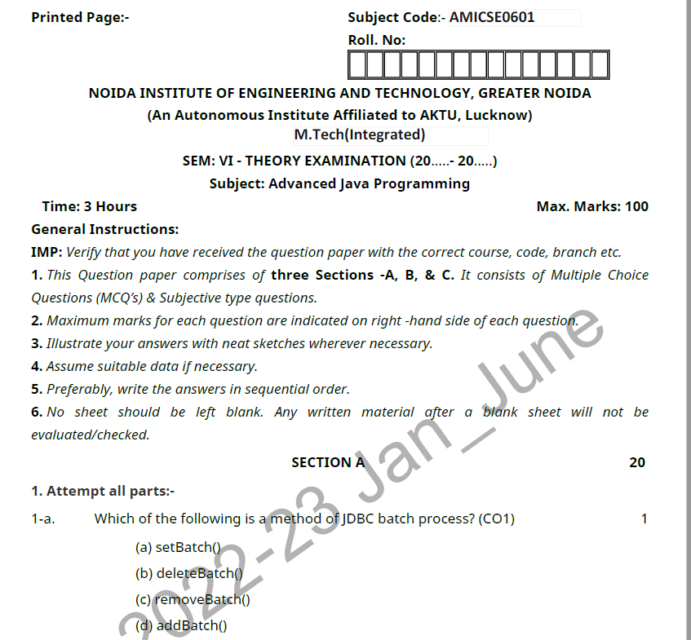
Old Question Paper
Ibrar Ahmed AMICSE0601/ACSE0601/ACSEHO601 Unit 1

Slide 121
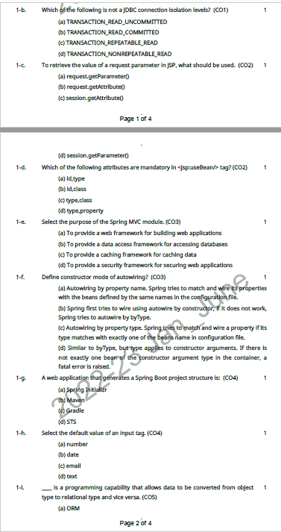
Old Question Paper(cont..)
Ibrar Ahmed AMICSE0601/ACSE0601/ACSEHO601 Unit 1

Slide 122
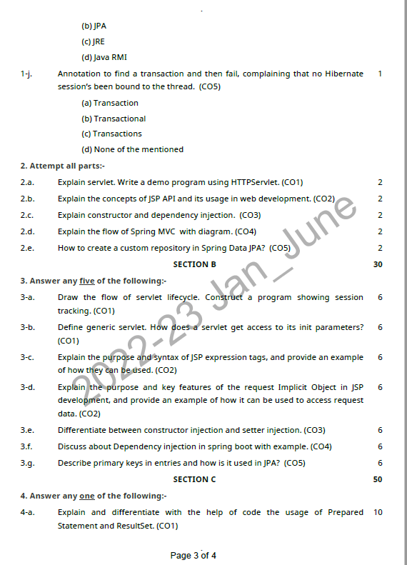
Old Question Paper(cont..)
Ibrar Ahmed AMICSE0601/ACSE0601/ACSEHO601 Unit 1

Slide 123
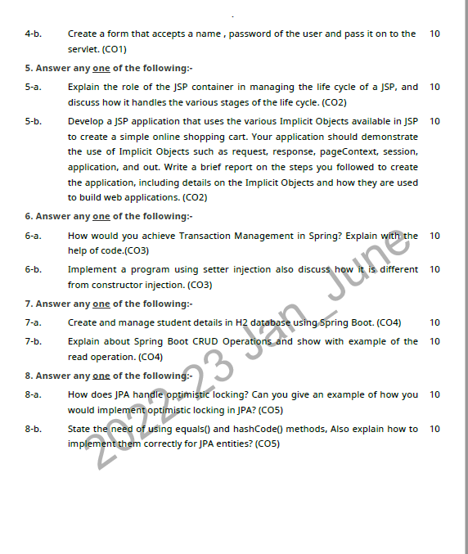
Old Question Paper(cont..)
Ibrar Ahmed AMICSE0601/ACSE0601/ACSEHO601 Unit 1

Slide 124
Expected Questions for University Exam
Discuss various types of driver used in JDBC details
Write a program to inserting multiple rows in emploee table by using PreparedStatement interface
Discuss about Servlet API in details descriptions
Explain the life cycle of servlet in details
Write a program that implement Session tracking by usin HTTPSession method.
Explain the process to handle the exception on your JSP page
What is purpose to use the web container in servlet.
Explain the reason to use sendRedirect() method in JSP with the help of suitable example.
Ibrar Ahmed AMICSE0601/ACSE0601/ACSEHO601 Unit 1

Slide 125
References
Bhave, “Programming with Java”, Pearson Education.
Naughton, Schildt, “The Complete Reference JAVA2”, TMH.
Deitel, “Java for programmers”, Pearson Education.
Tanveer Alam, Internet and Java Programming, Khanna Publishing House.
Balagurusamy E, “Programming in JAVA”, TMH
Ibrar Ahmed AMICSE0601/ACSE0601/ACSEHO601 Unit 1

Slide 126
Recap of Unit 1
Discussed Java Database Connectivity in details
Discussed about the parameterized query statement
Design and implent of stored procedure using JDBC
Explain the servlet overview and its architecture
Design and implementation of HTTP get and post request
Discussed about various types session handling in servlet
Discuss about the life cycle of servlet and jsp with their implementation
Ibrar Ahmed AMICSE0601/ACSE0601/ACSEHO601 Unit 1

Slide 127

Ibrar Ahmed AMICSE0601/ACSE0601/ACSEHO601 Unit 1

